Slide 1

Team A001
Cole Astaire – Producer
Hank Brobreck – Technical Director
Ryan Booth – Product Manager
Evan Kau – Design Director
Israel Zevenbergen – Test Director

Slide 2
Our Story

Slide 3
Pre-Alpha Data
Time-Between-Frames
Player Position / 5 Frames
Enemy Position @ Death
Enemy Position @ Damage Taken

Slide 4
Enemy Deaths – All Sessions

Slide 5
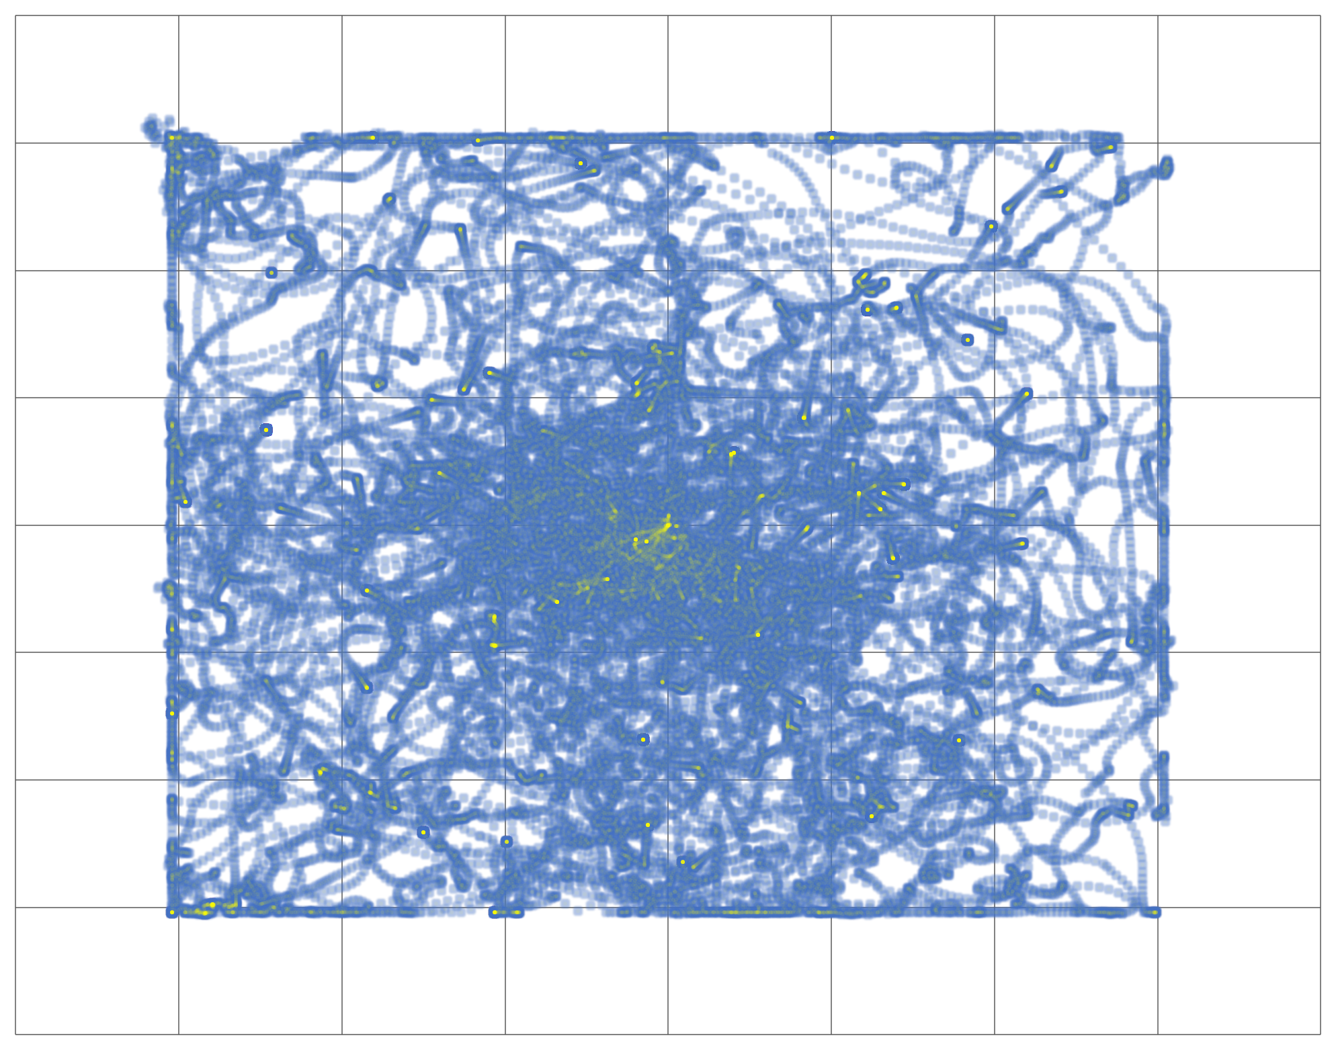
Player Position – All Sessions

Slide 6
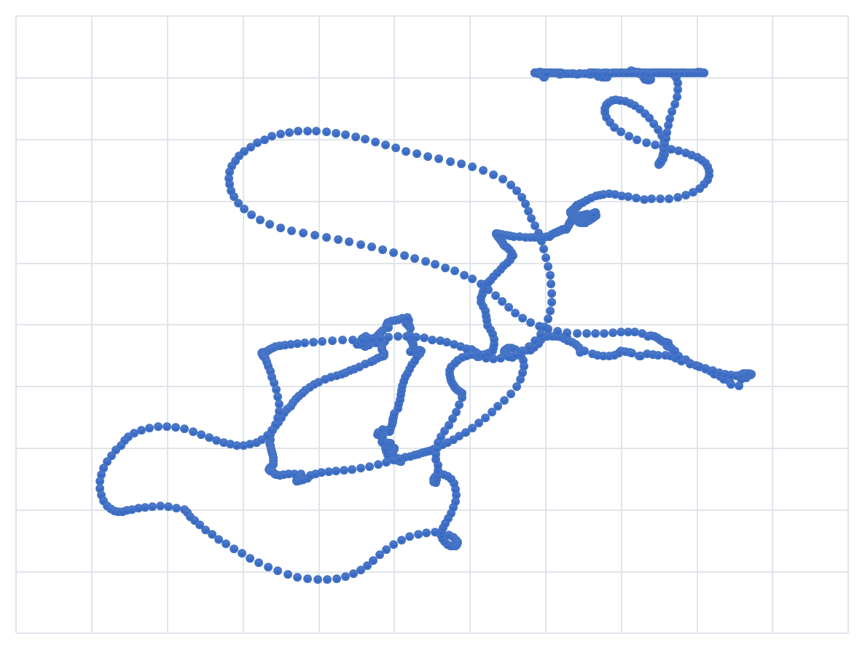
Player Position – Session 14877

Slide 7
Blasteroids + Space Blast
=
Blast Droids

Slide 8
Top 5 Game Names
5. Space Jam
4. Stalin’s Space Crusade
3. Bernie Sanders’ Social Game
2. Space Adventures Absolution Rising Revengeance Final Chapter Prologue Blood Money Amongst Thieves Reloaded
1. Leave Me and My Son Alone

Slide 9
What did we learn?

Slide 10
How to find
the game!

Slide 11
Method 1:
On a DigiPen Device,
or via DigiPen wi-fi.

Slide 12
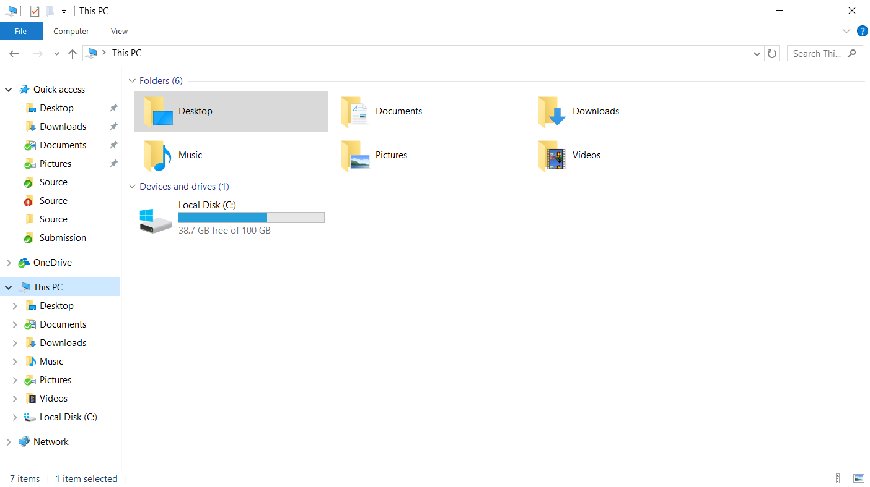
Open File Explorer

Slide 13
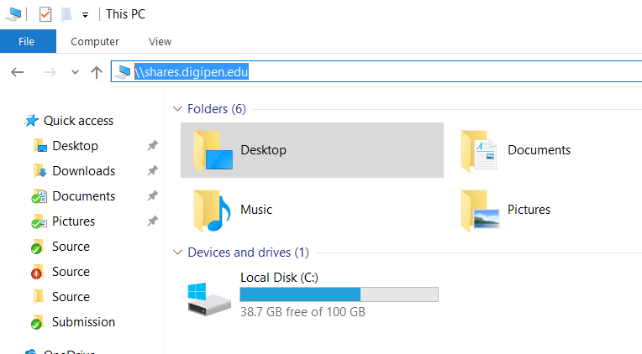
\\shares.digipen.edu\...

Slide 14
Method 2:
Via Dragon’s Den
Simply follow the same directory path using the student den explorer.

Slide 15
Method 3:
DigiPen Wiki
inside.digipen.edu/main/TeamA001

Slide 16


